Slide 1


Slide 2
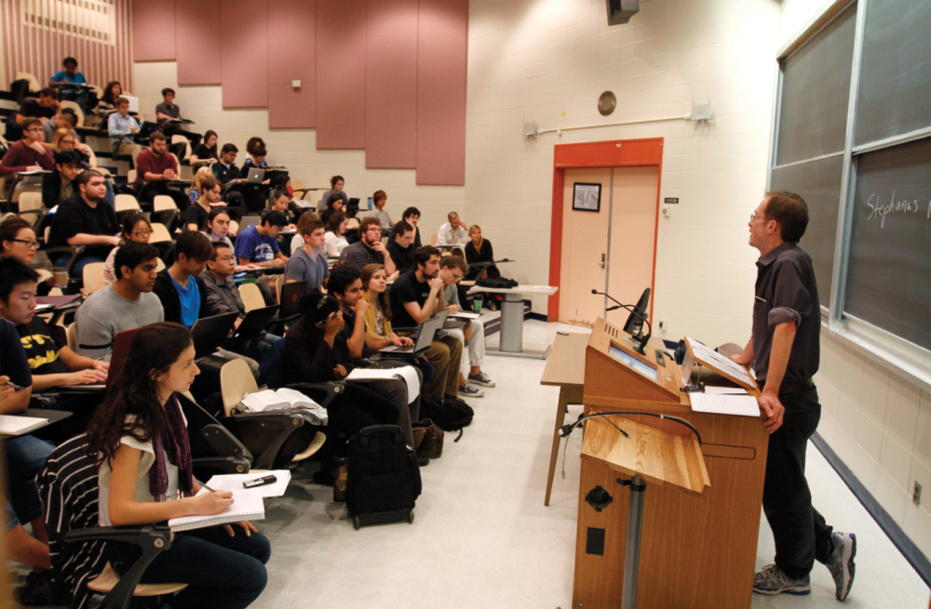
1
WHAT IS ECONOMICS?

Slide 3
After studying this chapter you will be able to
Define economics and distinguish between microeconomics and macroeconomics
Explain the two big questions of economics
Explain the key ideas that define the economic way of thinking
Explain how economists go about their work as social scientists and policy advisers
Copyright © 2013 Pearson Canada Inc., Toronto, Ontario

Slide 4
You are studying economics at a time of extraordinary change.
Your life will be shaped by the challenges you face and the opportunities that you create.
But to face those challenges and seize the opportunities they present, you must understand the powerful forces at play.
The economics that you’re about to learn will become your most reliable guide.
Copyright © 2013 Pearson Canada Inc., Toronto, Ontario

Slide 5
Definition of Economics
  All economic questions arise because we want more than we can get.
  Our inability to satisfy all our wants is called scarcity.
  Because we face scarcity, we must make choices.
  The choices we make depend on the incentives we face.
  An incentive is a reward that encourages an action or a penalty that discourages an action.

Slide 6
Definition of Economics
  Economics is the social science that studies the choices that individuals, businesses, governments, and entire societies make as they cope with scarcity and the incentives that influence and reconcile those choices.
  Economics divides in to main parts:
  Microeconomics
  Macroeconomics

Slide 7
Definition of Economics
  Microeconomics is the study of choices that individuals and businesses make, the way those choices interact in markets, and the influence of governments.
  An example of a microeconomic question is: Why are people buying more e-books and fewer hard copy books?
  Macroeconomics is the study of the performance of the national and global economies.
  An example of a macroeconomic question is: Why is the unemployment rate in Canada so high?

Slide 8
Two Big Economic Questions
  Two big questions summarize the scope of economics:
  How do choices end up determining what, how, and for whom goods and services get produced?
  When do choices made in the pursuit of self-interest also promote the social interest?

Slide 9
Two Big Economic Questions
What, How, and For Whom?
  Goods and services are the objects that people value and produce to satisfy human wants.
What?
In Canada, agriculture accounts for 2 percent of total production, manufactured goods for 20 percent, and services (retail and wholesale trade, health care, and education are the biggest ones) for 78 percent.
  In China, agriculture accounts for 11 percent of total production, manufactured goods for 49 percent, and services for 40 percent.

Slide 10
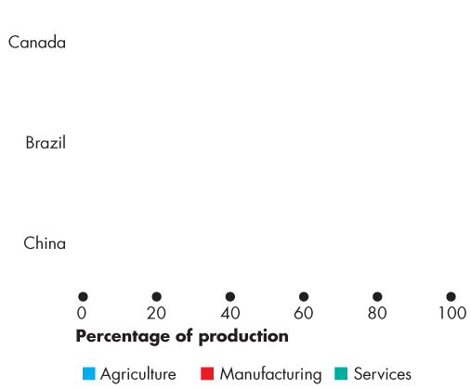
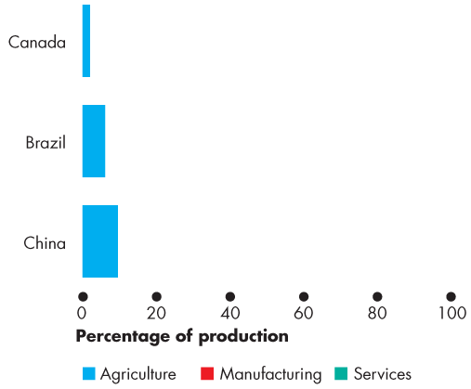
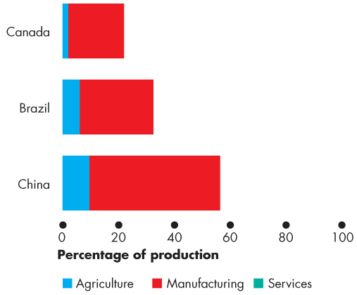
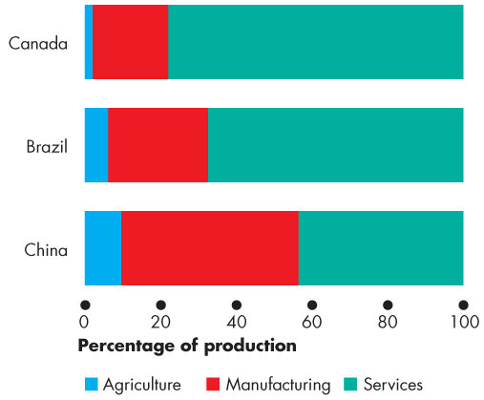
Two Big Economic Questions
  Figure 1.1 shows these numbers Canada and China.
  It also shows the numbers for Brazil.
  What determines these patterns of production?
  How do choices end up determining the quantity of each item produced in Canada and around the world?

Slide 11
Two Big Economic Questions
How?
  Goods and services are produced by using productive resources that economists call factors of production.
  Factors of production are grouped into four categories:
  Land
  Labour
  Capital
  Entrepreneurship

Slide 12
Two Big Economic Questions
  The “gifts of nature” that we use to produce goods and services are land.
  The work time and work effort that people devote to producing goods and services is labour.
  The quality of labour depends on human capital, which is the knowledge and skill that people obtain from education, on-the-job training, and work experience.
  The tools, instruments, machines, buildings, and other constructions that businesses use to produce goods and services are capital.
  The human resource that organizes land, labour, and capital is entrepreneurship.

Slide 13
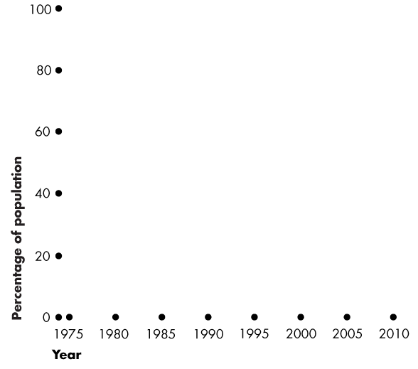
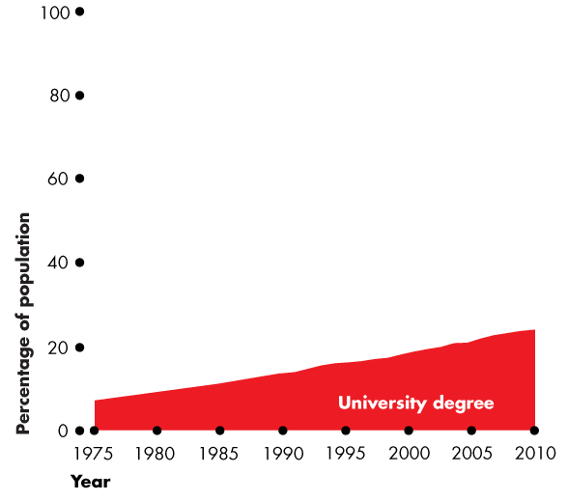
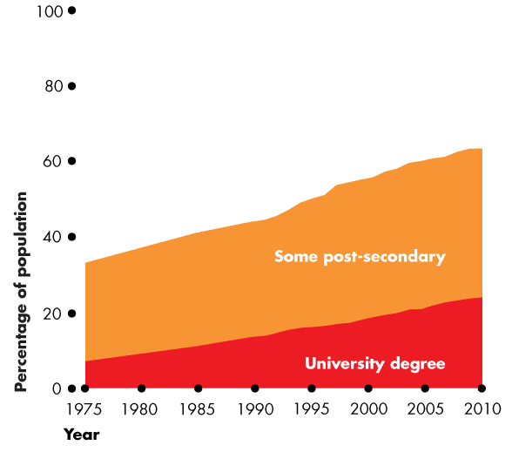
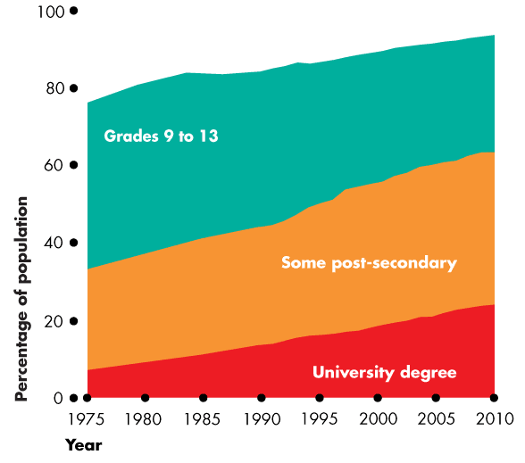
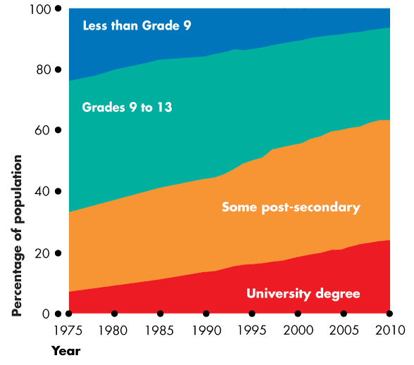
Two Big Economic Questions
  Figure 1.2 shows a measure of the growth of human capital in Canada over the last century—the percentage of the population that has completed different levels of education.
  Economics explains these trends.

Slide 14
Two Big Economic Questions
For Whom?
  Who gets the goods and services depends on the incomes that people earn.
  Land earns rent.
  Labour earns wages.
  Capital earns interest.
  Entrepreneurship earns profit.

Slide 15
Two Big Economic Questions
Can the Pursuit of Self-Interest Promote the Social Interest?
  Every day, 33 million Canadians and 7 billion people in other countries make economic choices that result in What, How, and For Whom goods and services are produced.
  Do we produce the right things in the right quantities?
  Do we use our factors of production in the best way?
  Do the goods and services go to those who benefit most from them?

Slide 16
Two Big Economic Questions
  Self-Interest
  You make choices that are in your self-interest—choices that you think are best for you.
  Social Interest
  Choices that are best for society as a whole are said to be in the social interest.
  Social interest has two dimensions:
  Efficiency
  Equity

Slide 17
Two Big Economic Questions
  Efficiency is achieved when the available resources are used to produce goods and services:
  At the lowest possible price and
  In quantities that give the greatest possible benefit.
  Equity is fairness, but economists have a variety of views about what is fair.
  The Big Question
  Can choices made in self-interest promote the social interest?

Slide 18
Two Big Economic Questions
  Four topics that generate discussion and that illustrate tension between self-interest and social interest are
  Globalization
  The information-age economy
  Global warming
  Economic instability

Slide 19
Two Big Economic Questions
  Globalization
  Globalization means the expansion of international trade, borrowing and lending, and investment.
  Globalization is in the self-interest of consumers who buy low-cost imported goods and services and …
  … in the self-interest of the multinational firms that produce in low-cost regions and sell in high-price regions.
  But is globalization in the self-interest of low-wage workers in other countries and Canadian firms that can’t compete with low-cost imports?
  Is globalization in the social interest?

Slide 20
Two Big Economic Questions
  The Information-Age Economy
  The technological change of the past forty years has been called the Information Revolution.
  The information revolution has clearly served your self-interest: It has provided your cell phone, laptop, loads of handy applications, and the Internet.
  It has also served the self-interest of Bill Gates of Microsoft and Gordon Moore of Intel, both of whom have seen their wealth soar.
  But did the information revolution serve the social interest?

Slide 21
Two Big Economic Questions
  Climate Change
  Every day, when you make self-interested choices to use electricity and gasoline, you contribute to carbon emissions.
  You leave your carbon footprint.
  You can lessen your carbon footprint by walking, riding a bike, taking a cold shower, or planting a tree.
  But can each one of us be relied upon to make decisions that affect the Earth’s carbon-dioxide concentration in the social interest?

Slide 22
Two Big Economic Questions
  Economic Instability
  Between 1993 and 2007, the Canadian and global economies expanded strongly. Incomes in Canada increased by 30 percent and incomes in China tripled.
  But in August 2007, a period of financial stress began that soon gripped the entire global financial system.
  The choices of U.S. banks to borrow and lend and the choices of people and business to lend to and borrow from U.S. banks are made in self-interest.
  Does this lending and borrowing serve the social interest?

Slide 23
The Economic Way of Thinking
  Six key ideas define the economic way of thinking:
  A choice is a tradeoff.
  People make rational choices by comparing benefits and costs.
  Benefit is what you gain from something.
  Cost is what you must give up to get something.
  Most choices are “how-much” choices made at the margin.
  Choices respond to incentives.

Slide 24
The Economic Way of Thinking
A Choice Is a Tradeoff
  The economic way of thinking places scarcity and its implication, choice, at center stage.
  You can think about every choice as a tradeoff—an exchange—giving up one thing to get something else.
  On Saturday night, will you study or have fun?
  You can’t study or have fun at the same time, so you must make a choice.
  Whatever you choose, you could have chosen something else. Your choice is a tradeoff.

Slide 25
The Economic Way of Thinking
Making a Rational Choice
  A rational choice is one that compares costs and benefits and achieves the greatest benefit over cost for the person making the choice.
  Only the wants of the person making a choice are relevant to determine its rationality.
  The idea of rational choice provides an answer to the first question: What goods and services will be produced and in what quantities?
  The answer is: Those that people rationally choose to buy!

Slide 26
The Economic Way of Thinking
How do people choose rationally?
The answers turn on benefits and costs.
Benefit: What you Gain
The benefit of something is the gain or pleasure that it brings and is determined by preferences
Preferences are what a person likes and dislikes and the intensity of those feelings.

Slide 27
The Economic Way of Thinking
Cost: What you Must Give Up
  The opportunity cost of something is the highest-valued alternative that must be given up to get it.
  What is your opportunity cost of going to an AC/DC concert?
  Opportunity cost has two components:
  1. The things you can’t afford to buy if you purchase the AC/DC ticket.
  2. The things you can’t do with your time if you go to the concert.

Slide 28
The Economic Way of Thinking
How Much? Choosing at the Margin
You can allocate the next hour between studying and instant messaging your friends.
The choice is not all or nothing, but you must decide how many minutes to allocate to each activity.
To make this decision, you compare the benefit of a little bit more study time with its cost—you make your choice at the margin.

Slide 29
The Economic Way of Thinking
  To make a choice at the margin, you evaluate the consequences of making incremental changes in the use of your time.
  The benefit from pursuing an incremental increase in an activity is its marginal benefit.
  The opportunity cost of pursuing an incremental increase in an activity is its marginal cost.
  If the marginal benefit from an incremental increase in an activity exceeds its marginal cost, your rational choice is to do more of that activity.

Slide 30
The Economic Way of Thinking
Choices Respond to Incentives
  A change in marginal cost or a change in marginal benefit changes the incentives that we face and leads us to change our choice.
  The central idea of economics is that we can predict how choices will change by looking at changes in incentives.
  Incentives are also the key to reconciling self-interest and the social interest.

Slide 31
Economics: A Social Science and Policy Tool
  Economist as Social Scientist
  Economists distinguish between two types of statement:
    What is—positive statements
    What ought to be—normative statements
  A positive statement can be tested by checking it against facts.
  A normative statement expresses an opinion and cannot be tested.

Slide 32
Economics: A Social Science and Policy Tool
  Unscrambling Cause and Effect
  The task of economic science is to discover positive statements that are consistent with what we observe in the world and that enable us to understand how the economic world works.
  Economists create and test economic models.
  An economic model is a description of some aspect of the economic world that includes only those features that are needed for the purpose at hand.

Slide 33
Economics: A Social Science and Policy Tool
  A model is tested by comparing its predictions with the facts.
  But testing an economic model is difficult, so economists also use
  Natural experiments
  Statistical investigations
  Economic experiments

Slide 34
Economics: A Social Science and Policy Tool
  Economist as Policy Adviser
  Economics is a toolkit for advising governments and businesses and for making personal decisions.
  All the policy questions on which economists provide advice involve a blend of the positive and the normative.

